Slide 1



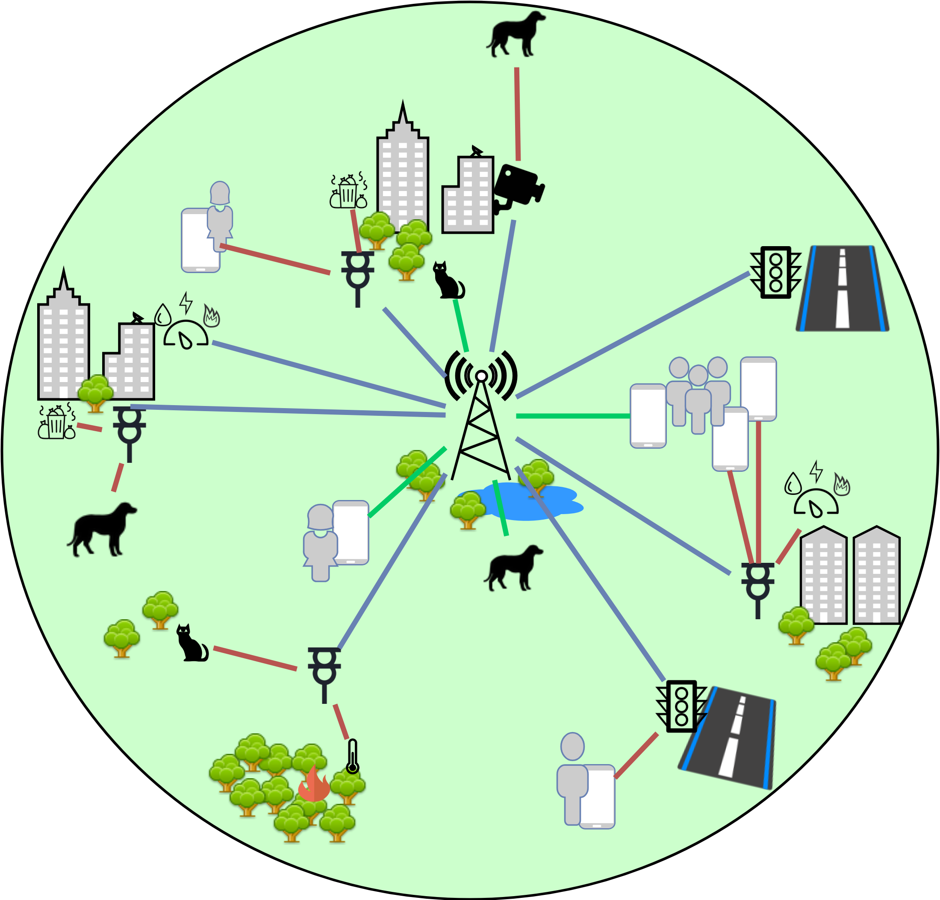
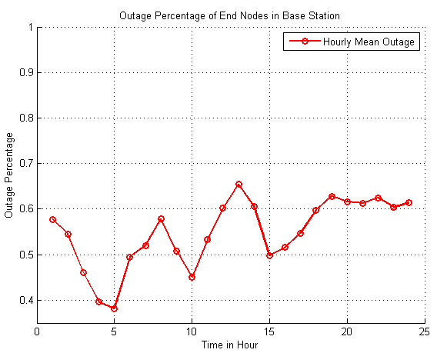
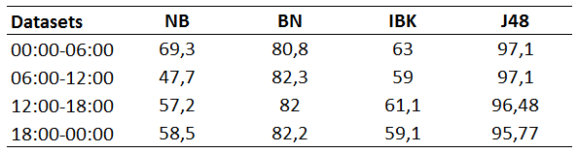
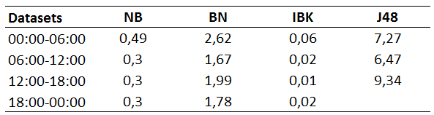
Cooperative Communication Topologies for Smart City IoT Applications
BLG 556E Digital Solutions for Smart Cities, Spring 2018 Term Project
Sinan Atan
atan@itu.edu.tr
504162306
Tuğrul Yatağan
yatagan@itu.edu.tr
504161551
Introduction
Smart cities are expected to provide their residents a variety of innovative services and applications using advanced technologies. These technologies are heavily influenced by recent communication methods. Wireless communication can provide flexibility and mobility to any smart city IoT application thus wireless connectivity has become more important to provide smart city IoT applications. Example smart city IoT applications which extensively need wireless communication can be; waste management, water/electricity/gas metering, environment/animal tracking, water/gas/fire detecting, and so on.
Wireless connection is expected to be reliable, efficient, scalable, fair, high throughput, low delay and green power in case of system design principles. It can be difficult to satisfy all these expectations due to the nature of wireless communication and behavior of wireless network entities. Mobile node which has low signal strength to base station may face drastic communication issues. To cope with this issue, relay nodes can be used to provide alternative communication path. This scheme is called as cooperative communication.
In this work, we propose a cooperative communication framework for smart city IoT applications which utilize machine learning methods to optimize relay node allocation policy.
Figure 1. Architectural decomposition of proposed cooperative communication topology.
Figure 2. Outage Probability of End Nodes During Day
Problem Description
Table 1. Correctly Classified Instances in Percentage
Table 2. Time Taken to Build Model in Seconds
Wireless communication reliability is severely affected by propagation medium and congestion. Either wireless communication throughput will decrease, or power consumption will increase if a network entity does not have a good communication path. If a wireless network entity tries to communicate through a longer path or through a heavily loaded (congested) node, not only its performance but the overall network performance will decrease due to the half-duplex nature of wireless communication.
Most of the wireless communication capable nodes are mobile, this makes it even more difficult to provide reliable wireless link between end nodes and base station. Thus, unpredictable channel state of mobility is the trade-off for wireless systems against flexibility.
In a common wireless smart city IoT application characteristics are;
Most of the entities are low power or mobile end devices: animal trackers, waste management devices, water/gas/fire sensors, water/electricity/gas meters, etc.
There are decent amount of fixed end devices which connected to power: traffic lights, street lamps, surveillance cameras, etc.
There is at least one base station which provides internet access to other entities.
Using these fixed end devices as relay nodes can improve overall network connectivity, reliability, efficiency, throughput, delay and jitter. Mobile end nodes are not aware of the network topology thus they tend to select nearest relay node to reach base station. But selecting nearest relay node may not be the optimum solution for a mobile end node.
Results
In this work, we use Weka tool to analyze data set and performance of three different machine learning algorithms are surveyed; BayesNetwork, NaiveBayes, IBk and J48 (C4.5). We try to select the best algorithm. Processing power is not a constraint as calculations are done in base station. Results are fetched daily to end nodes as trained model to use for their future selections. Any failure in relay selection would lead to duplicated signaling which impacts the system performance.
We applied some assumptions to simplify our model;
Only relay nodes are considered to cooperate with end nodes; cooperation between end points is not considered in the scope of this work.
Only end points with lower capacity than required throughput is expected to cooperate.
Clients are served as first in first out policy; no end point does a relay selection for speculated utilization by different end nodes in the future. End nodes only utilize single relay at a time.
Data set includes 1 base station, 5 fixed relaying nodes, 50 mobile end-user nodes and 50 mobile IoT sensor nodes. Technology-wise capacity of end-users and IoT sensors are 20 Mbit/s and 4 Mbit/s respectively. Similarly, relays have 200 Mbit/s capacity which does not vary due to fixed location and base station is considered to have unlimited capacity. Throughput of IoT sensors are fixed and 2 Mbit/s. End user throughput patterns vary during the day. Coverage area of the system is considered to be 10km in diameter, base station is located in the center of the area, and all end-users and IoT sensors reside within this range during the day, neither any endpoint leaves nor enters the system. Similarly, relays are geographically distributed in the coverage range.
Source data is generated in MATLAB, reflecting real world implementation as much as possible. Outage probabilities are modelled aggressively to benchmark machine learning algorithms and an average of 0.5 is captured as seen in Figure 2. Data is captured for 90 days and analyzed in 4 periods of day as 00:00-06:00, 06:00-12:00, 12:00-18:00 and 18:00-24:00.
Table 1 and Table 2 give the results of compared algorithms in case of accuracy and computation speed. As seen below J48 outperforms all other with the cost of processing time for each period. As stated before process cost is not important due to nearly unlimited processing power in base station. BayesNetwork as well provides sufficient performance for cooperation with reasonable cost. IBk also performs reasonable with very few cost. It can be the best option if ML to be implemented in end nodes.
Proposed Framework
In our framework, we introduce a cooperation framework which use historic data as input and by the help of machine learning, assignment of cooperation relay is done for end nodes. This achieves better utilization of power by avoiding extra wireless signaling for resource allocation. Furthermore, when an end node is not in the coverage area of the base station, assignment of cooperation fails in classical methods. Our scheme eliminates those issues as well.
We utilize fixed relaying nodes for cooperative communication. Scale of fixed nodes in a common smart city application should be sufficient to cover most of the mobile end nodes. Furthermore, mobile end nodes should not waste their limited energy resources since they wouldn't continuously listen medium to participate wireless cooperation. We create a simple model for a common smart city application containing; one base station, N fixed relays, M_{UE} end-user and M_{IoT} sensor mobile end nodes. Proposed smart city application framework topology is illustrated in Figure 1.
In this architecture, we modelled every wireless node with following parameters;
Time [0-23]: Time information is used as input, since usage and mobility characteristics of nodes change during the day.
Node ID [0-(N+M_{UE}+M_{IoT}+1)]: Unique identity of each node in the system. Cooperation pattern of each individual node in the network is tracked by node ID.
Type {base, relay, end-user, IoT device}: Node type illustrates the category of each device to do a better classification for each node in the network in terms of mobility, usage, etc.
Capacity [0-100]: Maximum throughput, towards base station, can be achieved by each node in a certain state. This is derived from underlying radio access technology capacity, but it reflects instantaneous value in specified condition.
Rate [0-100]: Utilized throughput by each node. Rate is less than or equal to capacity for any node in the network.
Distance to base station [0-5000]: Channel quality and signal strength are measured with distance factor from base station. This provides rough estimation of instantaneous capacity for end points.
Distance to relay nodes [0-5000]: Similar to distance to base station, rather gives channel status information for each relay.
d
Selected relay [0-1000]: Output parameter of classification, which gives the selection for each end node to cooperate. Each end node tries to select best relay for itself.
Base station and relay nodes can be able to obtain this data during daily operation. From this obtained data, base station can train a model for every end node. Base station should share this trained model with end nodes daily. Then, every end node can be able to select the best possible relay for cooperative communication. End nodes can select relay nodes offline. They don’t need to know current network topology or they don’t require any external information.
Conclusion
In this work, we proposed a cooperative communication framework for a common smart city IoT application. Proposed framework uses machine learning methods by training data obtained from base station and fixed nodes, then framework uses this trained model to provide optimum relay node selection to mobile end nodes with reduced complexity.
Proposed framework shows that machine learning methods can classify the data well, which can be used as an input for future selections. This would improve overall reliability, efficiency, throughput, delay and jitter of the wireless network. Numerical model results are shown the effectiveness of the proposed scheme.
Obtaining real world data is important for future studies. As well as scale of the environment and cooperation between mobile nodes are some of the further studies in this topic.
References
[1] U. Raza, P. Kulkarni and M. Sooriyabandara, "Low Power Wide Area Networks: An Overview", IEEE Communications Surveys & Tutorials, vol. 19, no. 2, pp. 855-873, second quarter 2017
[2] “Cellular networks for massive IoT: Enabling low power wide area applications,” Ericsson, Stockholm, Sweden, Tech. Rep. UEN 284 23-3278, Jan. 2016.
[3] Y. He, F. R. Yu, N. Zhao, V. C. M. Leung and H. Yin, "Software-Defined Networks with Mobile Edge Computing and Caching for Smart Cities: A Big Data Deep Reinforcement Learning Approach," in IEEE Communications Magazine, vol. 55, no. 12, pp. 31-37, Dec. 2017.
[4] A. Al-Fuqaha et al., “Internet of Things: A Survey on Enabling Technologies, Protocols, and Applications,” IEEE Commun. Surveys & Tutorials, vol. 17, 4th qtr. 2015, pp. 2347–76.
[5] T. Taleb et al., “Mobile Edge Computing Potential in Making Cities Smarter,” IEEE Commun. Mag., vol. 55, no. 3, Mar. 2017, pp. 38–43.

